Slide 1
Weekly Meeting
Grace Sian
Sept 22, 2025

Slide 2
Weekly research progress
Finished
Abstract - Introduction
Gunshot data compared to paper
MATLAB code
On-going
Recording Data [40%]
Writing paper draft for 2026 VFS [30%]

Slide 3
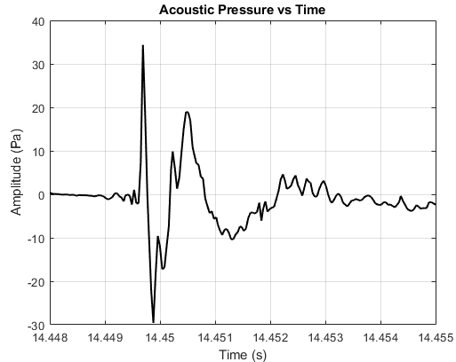
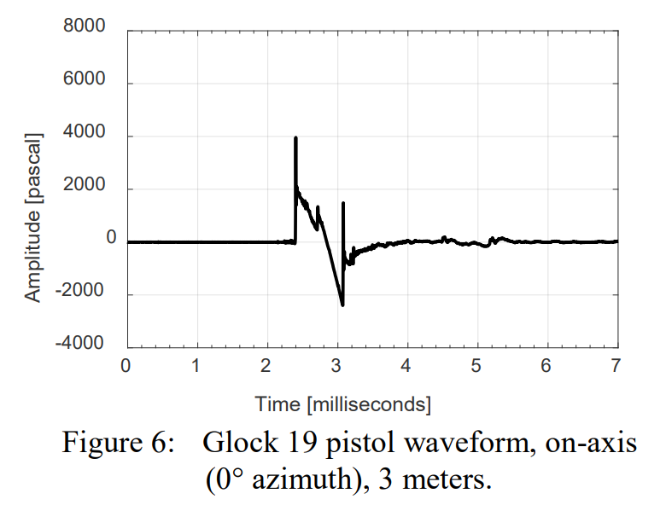
Result
Our gunshot data
Maher, R. C., and Routh, T. K., 2017, “Gunshot Acoustics: Pistol vs. Revolver,” Audio Engineering Society.

Slide 4
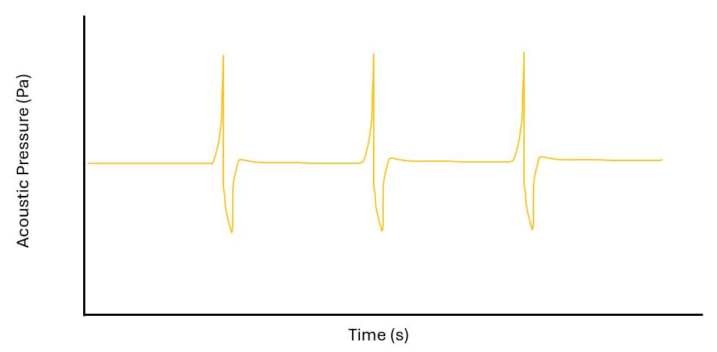
Result (expected and collected)
Last week expected result
This week result

Slide 5
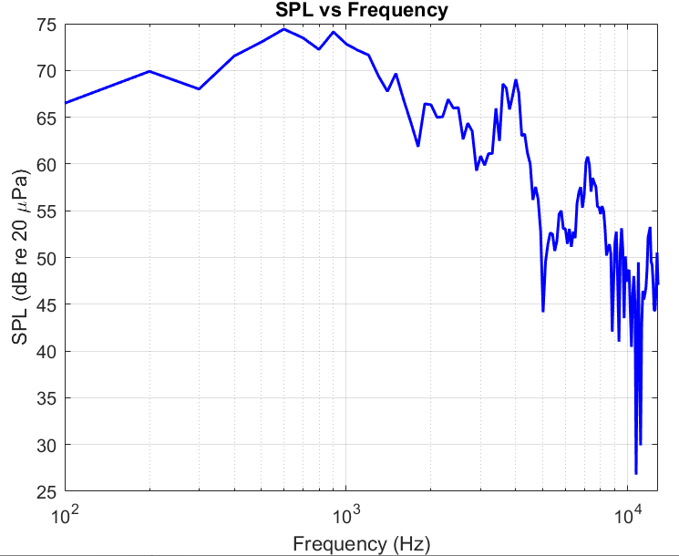
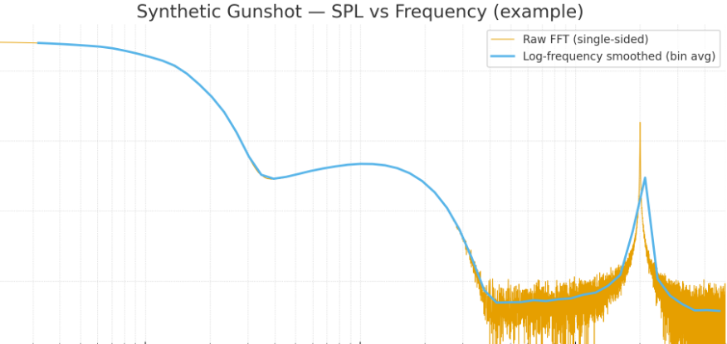
Result (expected and collected)
ChatGPT example gunshot SPL vs Freq
Our gunshot data SPL vs Freq

Slide 6
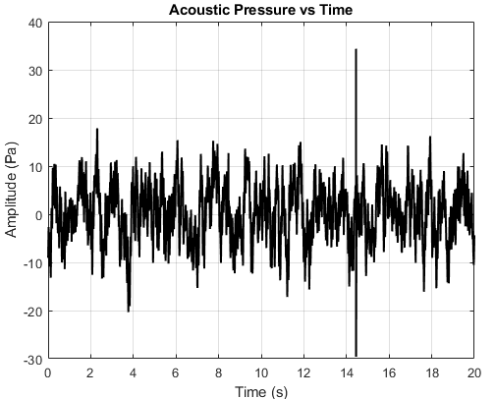
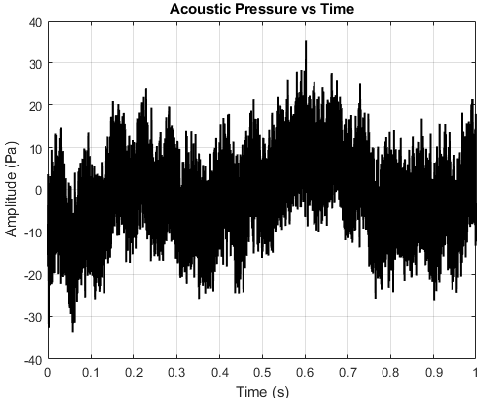
Amplitude Comparison
Gunshot amplitude AP vs time
Propeller amplitude AP vs time

Slide 7
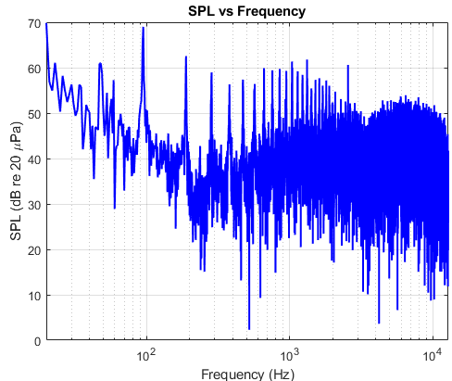
Result (propeller only)
Propeller AP vs time data averaged 20s
Propeller only SPL vs Freq

Slide 8
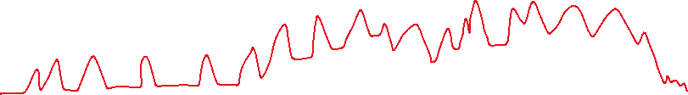

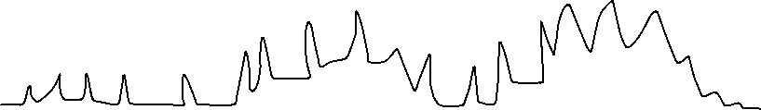

Visualized figure for VFS abstract (next week)
Prop
SPL (dB)
gunshot
gunshot
Prop + gunshot
Frequency (Hz)

Slide 9
Tasks
Collect data (0-degree)
Gunshot only
Compare to raw data again
Propeller only
Both together
Write VFS abstract – method, prelim, paper plan
Fill out Plan of Study

Slide 10
Others
Committee:
Dr. Muwanika would love to, but Ms. Em says it is not possible.
A friend says there’s paperwork that might be able to make it happen.

Slide 11
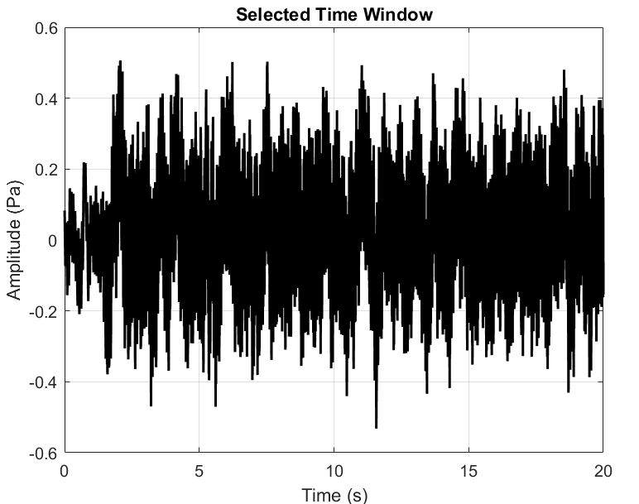
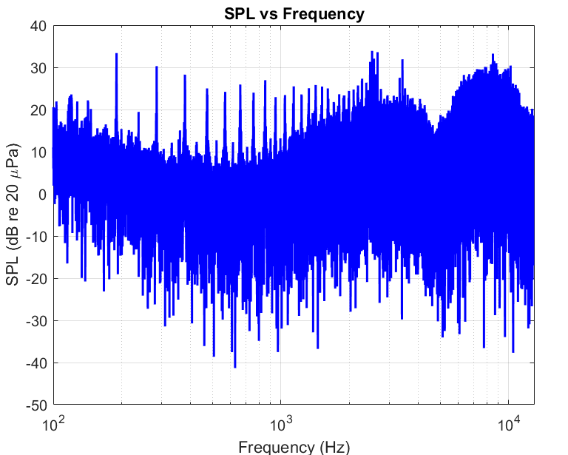
Prop no avg
22Sep_16in_proponly_0deg 2850RPM 1 lbf

Slide 12
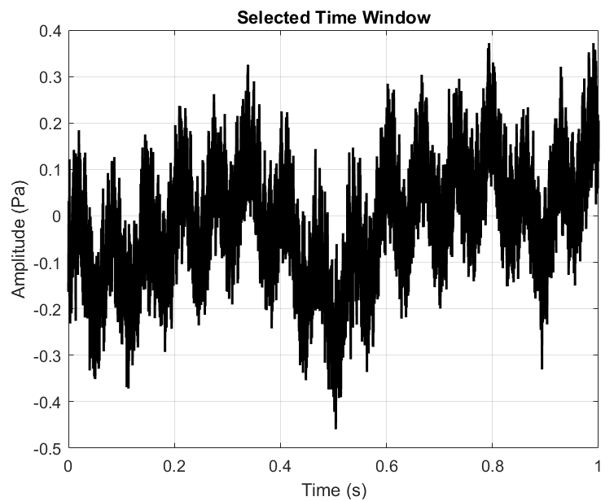
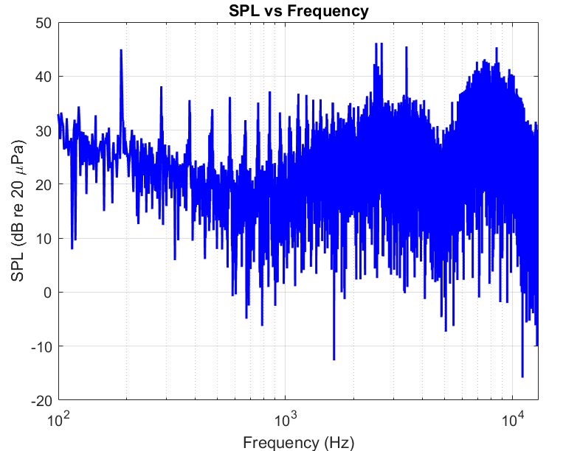
Prop only avg
22Sep_16in_proponly_0deg_avg

Slide 13
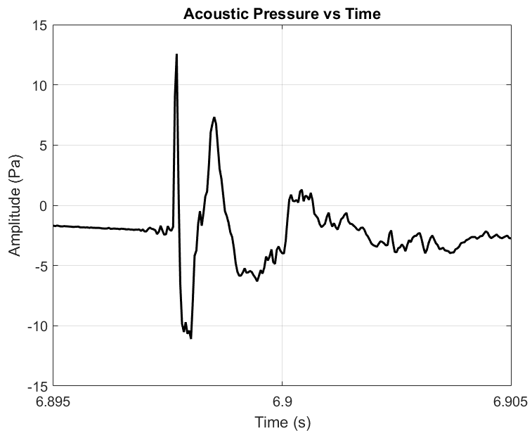
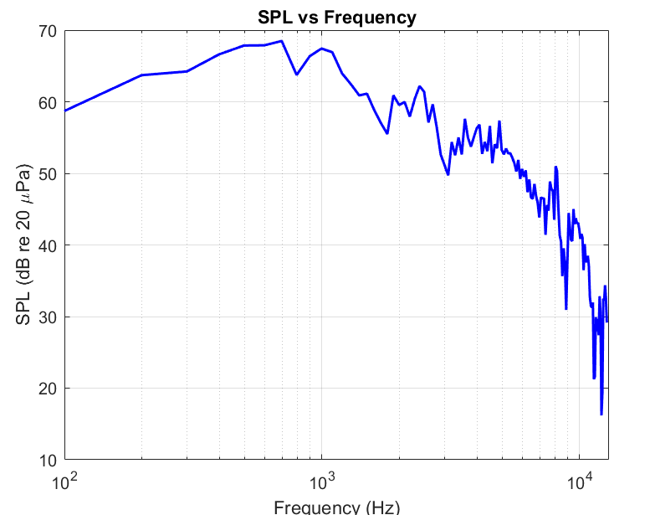
gunshot

Slide 14
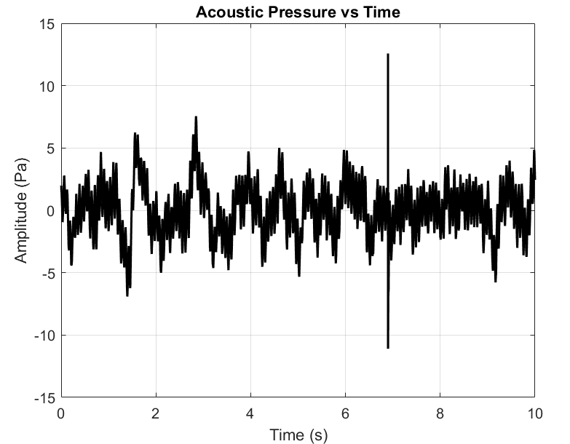
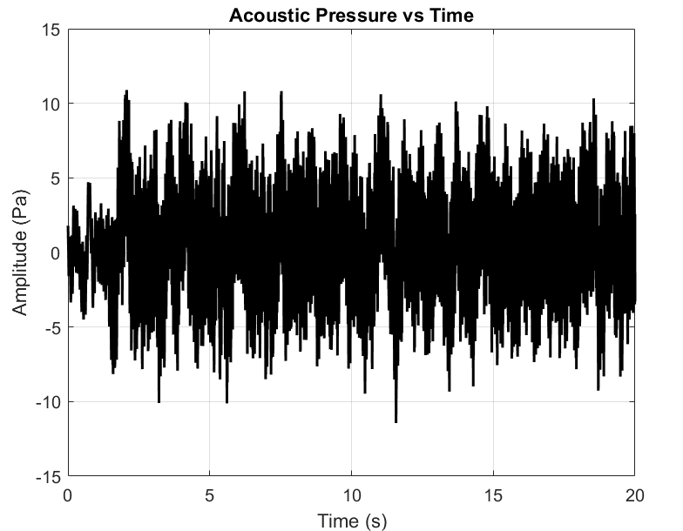
Gunshot prop comparison (89)
gunshot AP vs time (not avg)
Propeller AP vs time (not avg)

Slide 15
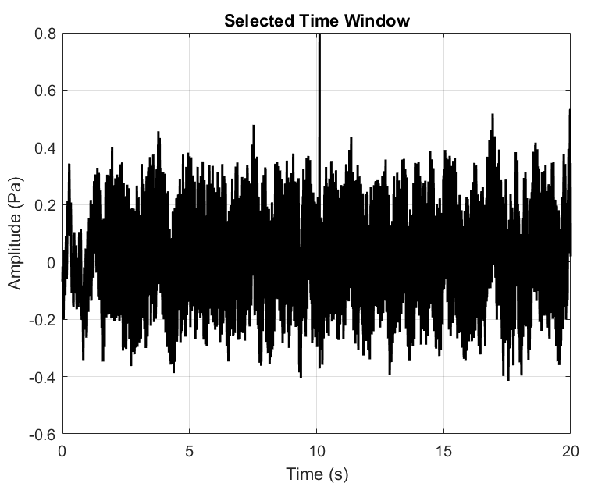
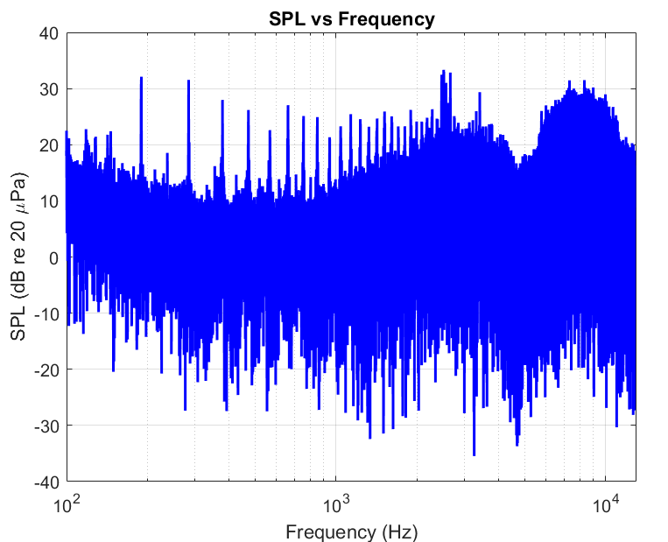
Both (try 1)

Slide 16
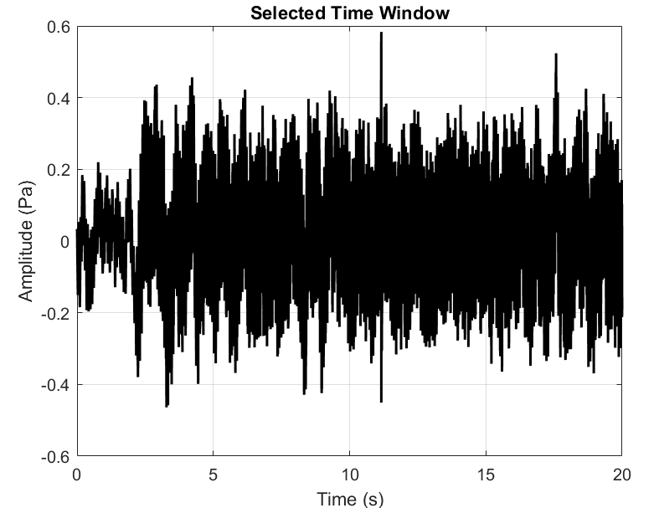
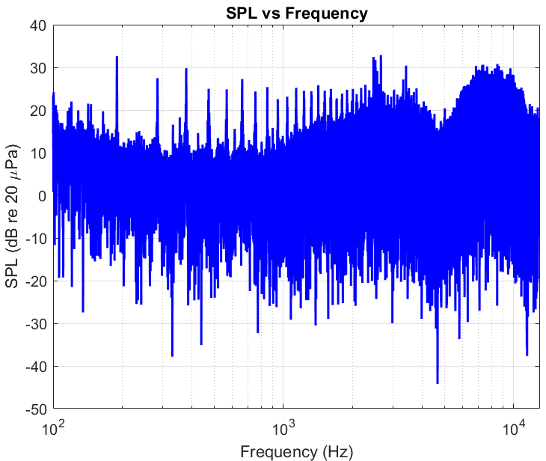
Both (89)

Slide 17
Weekly self evaluation
Items | Self grading
I made quality result figures | 6
I become more knowledgeable in the research area | 6
I made sufficient weekly progress towards publication goals | 6
Grading in the scale of 1~10
Additional comments if any

Slide 18
[Present your results] ~10 pages
Results must be presented in Figures or Tables
If you are in the literature review phase of a project, present other people’s results from the papers.
The next page shows a good example of presenting the results.
Clear figures.
Minimal text with arrows to label the figures
Brief explanation of what happened

Slide 19
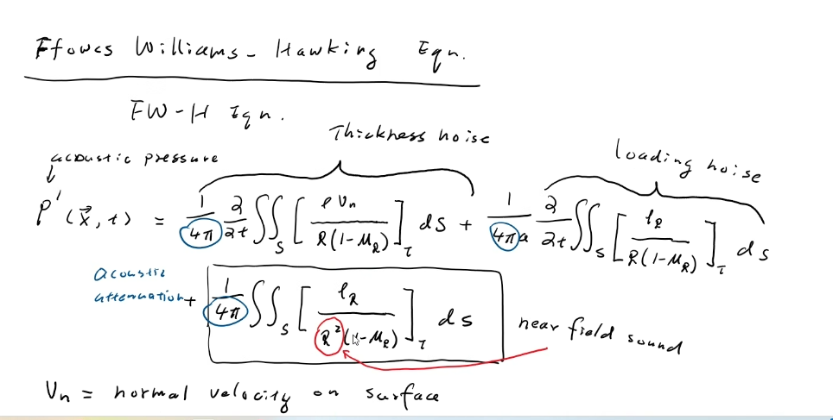
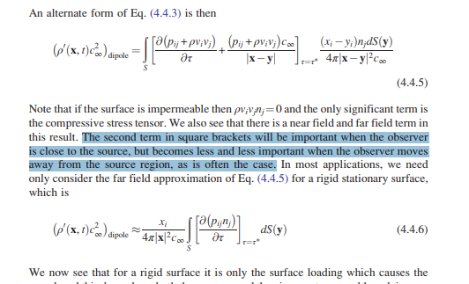
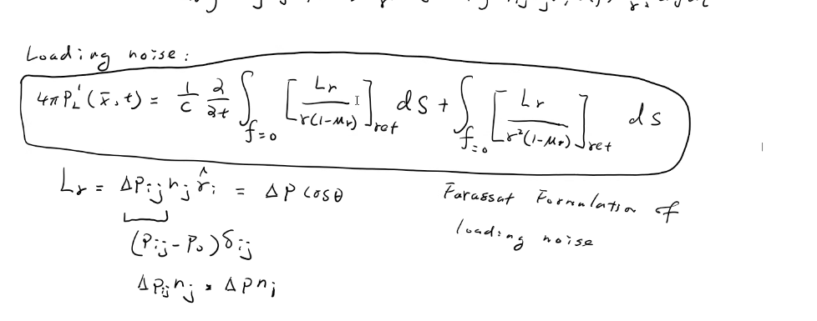
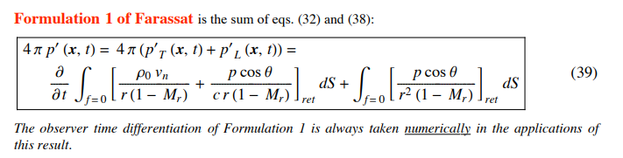
Farassat eq
Loading term (loading from propeller)

